Slide 1

Cash and Working Capital Management
Guidance on Forecasting Roll-Out and Monitoring
The full scope of Cash and Working Capital Management (CWCM) services is not permissible for SEC audit clients and their affiliates or IFAC PIE audit clients and their related parties. CWCM services are generally permissible for IFAC non-PIE audit clients subject to evaluating engagement circumstances using the conceptual framework (i.e. threats and safeguards approach) and provided we do not assume a management responsibility as outlined in the Global Quality & Risk Management Manual Chapter 11. See detailed guidance regarding Independence on slides 11-16 of the CWCM methodology guide.
RESTRUCTURING
August 2008
ADVISORY
For the purpose of this document, all references to KPMG International, a Swiss cooperative that serves as a coordinating entity for a network of independent member firms operating under the KPMG name, will be referenced as KPMG International. Throughout this document, "KPMG" ["we," "our," and "us"] refers to the local, independent KPMG member firm or firms. Throughout this document “client” [“they,” “their and “them”] refers to the local, independent member firm’s client. KPMG International provides no client services.

Slide 2
Contents
Topics Covered Slide Number
Purpose of this document Slide 2
Forecasting Overview Slide 3
Forecasting Roll-out
Section 1 – Overview Slide 4
Section 2 – Forecast implementation/roll-out Slide 8
Section 3 – Monitoring and Support Slide 16
Section 4 – Acronyms Slide […]

Slide 3
Purpose of this document
  This document has been prepared to assist staff in engagements where a short term cash flow forecast is to be implemented in a non-distressed environment. This guidance is not meant to be comprehensive. It should be used as a reference tool and lays down some rules that are considered to be good practice.
  We are regularly asked to comment on cash-flow forecasting processes within businesses. These requests can come from management and/or investors in the businesses e.g., Private Equity houses. The purpose of these requests are to strengthen existing forecasting processes and/or introduce new forecasting processes.

Slide 4
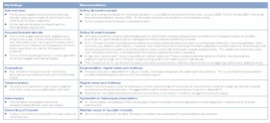
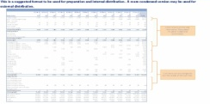
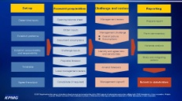
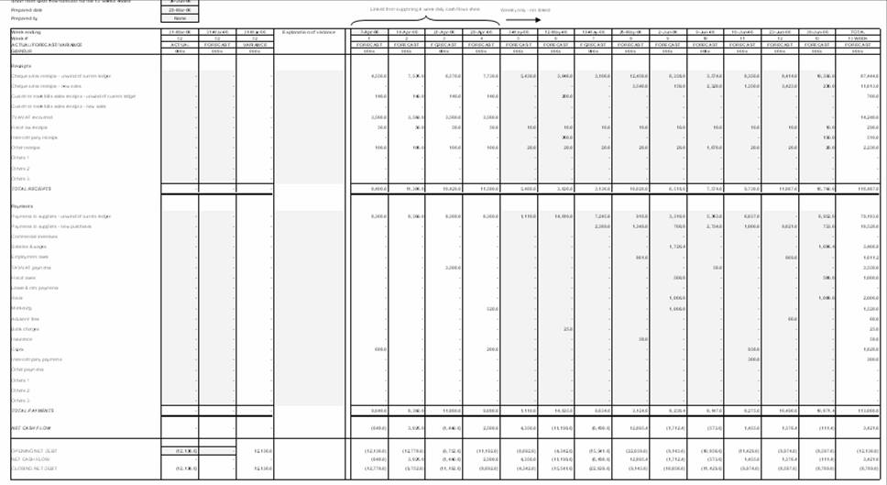

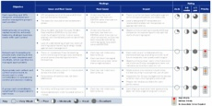
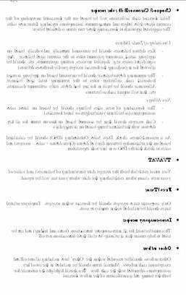
Cash and Working Capital Management for Corporates and PE
Forecasting – Overview
The typical approach during a forecasting – non-crisis engagement can be summarised as follows:
Project kick-off and information request
1
Forecasting assessment
2
Evaluation and development of recommendations
Group treasury and review
KPMG experience/ benchmarks
3
Develop revised forecasting process
Current state assessment
4a
Business unit reviews
Group requirements
Business unit involvement
This document covers this area
Process design
Revised forecasting process
Forecast roll-out
4b
Pilot entity trial
Re-forecasts
KPMG prior experience
Monitoring and support
Roll out to other businesses
Example Output
Key findings
Case for change
Design layout
Leading practice
Forecasting process
Tools
Instructions

Slide 5
Section one
Overview

Slide 6
Cash flow forecasting – Overview
Overview
  We provide increased visibility over a Group's future cash needs by preparing a cash flow forecast. The cash flow forecast should be:
    A rolling receipts and payments forecast
    A minimum of 13 weeks visibility, though this is often extended to 17 weeks if the forecast is only updated on a monthly basis
    Anchored to the most recent balance sheet and financial information
    Capable of being reconciled to the long-term cash flow forecast
  The forecast should be updated weekly or monthly as needed for actual performance and known changes to assumptions and in accordance with other accounting timelines.
  There should be a full re-forecast following completion of monthly management accounts which provide new anchor points.
  Forecasting is not an exact science and items will appear without warning. The process of identifying variances and amending the forecast through an iterative process increases the accuracy of the forecasts over a period of time.
  The forecast should be designed to enable, where possible, an element of automation in both its preparation and variance analysis. Typically the cash flow forecast line items will reflect the chart of accounts.
Why forecast?
  Management and stakeholders need visibility over the level of immediate and short term funding needs. A detailed short term receipts and payments cash flow forecast is expected by most stakeholders, especially private equity houses and lenders.
  The preparation of a short term receipts and payments cash flow forecast will identify for management:
    Key cash drivers and trends in the business
    Sensitivities and risks
    Opportunities to increase headroom

Slide 7
Cash flow forecasting – Overview
Why forecast (continued)?
  The benefits of a short term cash flow forecast include:
    It identifies the key drivers of a company’s cash flow and highlights the control needed to deliver the forecast result
    It enables management to proactively manage the cash flow as they have visibility of a potential issues in advance
    Identify trends in the business and possible opportunities to drive out headroom
    It is a key element of embedding a cash culture within a business
Principles of a successful cash flow forecasting process
  The format should be a receipts and payments cash flow forecast which captures all flows and has a clear anchor point.
  Key steps in a successful cash flow forecasting process are:
    Proper set-up and design e.g. templates, instructions, etc.
    The forecast should be anchored to a balance sheet with further inputs to the cash flow forecast received from the ‘owners’ of those areas across the business.
    Assumptions documented with local and senior management challenge
  Variance analysis of forecast against actual and forecast against reforecast should be undertaken.
  A commentary should be prepared covering key items and assumptions.
  For some line items in a forecast it is sometimes sensible to have a trade-off between 100% accuracy and timeliness of information. For example, the opening cash balance should be concise, but overhead expenditure could be based on reasonable assumptions rather than precise accuracy. As previously stated, all assumptions should be documented so that they can be challenged for reasonableness and any variances to forecast can be explained.

Slide 8
Cash flow forecasting – Overview (cont.)
Speed of preparation
  In non-distressed situations cash flow forecasting tends to have a slow and measured approach whereby the forecasting processes are developed and rolled out over a number of weeks/months via multiple site visits or workshops.
  The principles of good cash flow forecasting need to be adhered to and it is likely the KPMG team will have the time to make site visits to most material entities who will be needed to prepare forecasts or hold workshops for country controllers.
  In our experience, rolling out and developing cash flow forecasts on non-distressed cash engagements is achieved through:
    Working with Group Finance to commence and manage the process including initial communication to local controllers.
    Working with multiple user groups, inputters and compilers in order to design a management tool that is useful and will be used in the business going forward.
    Developing for and issuing to local controllers:
      Cash flow forecast format
      Templates to populate the forecast
      Instructions on how to complete the forecast
      Timetable for delivery
    Reviewing and challenging initial submissions, usually via phone calls and using available financial information such as management accounts.
  Undertaking a slower roll-out, variance analysis and regular challenge which improves accuracy over time and as compilers become more familiar with their task.

Slide 9
Forecast Implementation / roll-out

Slide 10
Steps in rolling out a forecast
  A slow and measured approach.
  The forecasting processes are developed and rolled out over a number of weeks/months via multiple site visits or workshops.
  Reviewing and challenging initial submissions.
  Variance analysis and regular challenge improves accuracy over time.

Slide 11
Pilot and roll out
How?
  Communicate purpose and reasons for the change.
  Distribute new forecast template/ instructions/timetable to pilot entities.
  Assistance on practical issues regarding the forecast preparation.
  Assistance in forecast population, review and challenge.
  Local management sign-off of forecast.
  HO review and consolidation.
Entity 1 roll out
Entity 2 roll out
Entity 3 roll out

Slide 12
Roll out – Example pilot countries and actions
Phase I: Pilot countries
Holland | UK | IT
Establish weekly actual cash flow reporting Review actuals for w/e 24 August. Variance analysis to identify weaknesses and improvements. | Review and feedback on first forecast and assumptions (expected on 24 August) Review and feedback on first actual cash flows for w/e 31 August | Conference call with team on return from holiday Site visit to compile first forecast, document process, assumptions and responsibilities. Review and feedback on actuals.
Phase II: Wider group roll out
Agree Phase II countries: Germany (priority) France Holdings US Spain | Group update to all countries on forecasting pilot project. Distribute template and instructions to phase II countries. Arrange forecasting workshops to include all inputters. Site visits to produce first forecast iterations.

Slide 13
Roll out – Example steps to date
Week commencing | Activities
23 July | Group requirements identified Cash flow template and instructions manual drafted Initial meeting with Treasury and Endemol Netherlands Template agreed in the Group and distributed to pilot countries
30 July | Site visits to UK, Netherlands and Italy Project overview to pilot countries, forecasting roll-out, data requests on improvement opportunities set out Template revisions and improvements
6 August | Update meeting at Group Assessment Treasury opportunities Additional meetings in Netherlands
13 August | Forecasting update meetings in Netherlands Initial queries sent to UK
20 August | Forecasting update and opportunities meetings in Netherlands Initial responses from UK

Slide 14
Roll out – Example status of roll out
 | Planning and preparation of templates and instructions | Rollout and team briefings | First forecast | Assumptions review and issue identification | First actuals and variances | Overall status
Group | ✓
NL |  | ✓ | ✓ | ✓ | 27-08-2007
UK |  | ✓ | 24-08-2007 | 24-08-2007 | 03-09-2007
IT |  | ✓ | mid-September

Slide 15
Roll out – Example Issues
Issues
  Senior management buy-in in NL and UK.
  Production costs source data:
    Not phased
    High volume/small value
    Data from Group required to complete
  Manual data/systems
  Short terms of trade
  No purchase order system
  Cash transactions

Slide 16
Roll out – Example Recommendations
Recommended improvements
  Roll out of recording of purchase orders/committed funds
  ‘Holistic’ project monitoring to consider:
    Cash flows
    Amounts due to/from customers
  Weekly review of forecasts, actuals, variance analysis and next steps

Slide 17
Remaining steps…..
How?
  Review of actual cash flows and variance analysis to identify and remedy issues.
  Variance analysis of subsequent re-forecasts with base forecast to identify any other forecasting issues.
  Roll out of process to other entities building on experience from first phase.
  Consolidation of Group forecast and assumptions.
Monitoring and support
Roll out to other businesses

Slide 18
Monitoring results
  There are two types of monitoring undertaken on a regular basis, both should be prepared when updating forecasts.
Monitoring
Type of monitoring | Purpose and basis of preparations | Potential benefits
1. Actual versus forecast | Daily/ weekly comparison of actual result versus forecast result Line item review to identify variances Proper explanation of variances Timing of inflows/outflows Permanent change to assumptions Timing variance will reverse in the future e.g., supplier payment not made this week but will be made next week Permanent variance will not reverse in the future e.g., bad debt | Identify errors in: Forecasting methodology Completeness of cash flow Impact of variances shown are reflected in the preparation of new forecast
2. Forecast versus reforecast | Comparison of current forecast to previous forecast Explain differences in weekly flows | Identify changes in assumptions Determine any corrective action required in advance of finalising forecast Major changes in forecast can be explained to stakeholders in advance

Slide 19
Example Forecast vs. Actual
This format below conforms with better practice.
Company ABC
Analysis of difference
£
000
Actual
Forecast
Variance
Permanent
Timing
Explanation
Trading receipts
Sales - unwind of debtors ledger
29,638
29,944
(306)
(58)
(248)
Underpayment of £
58
,
000
by XXX due to poor service
.
Deferral of £
248
k payment by XXX
.
Sales - new sales
22,321
22,378
(57)
(57)
Net deficit of sales from 8-29 April (=270+260-293-295)
VAT recovered
-
-
-
Interest receivable
87
90
(3)
(3)
Reduction in LIBOR of 25 basis points leads to less interest received from week ending 15 April
Other receipts
26,160
25,847
313
313
-
Higher proceeds from disposal of business in week ending 18 March due to competitive bidding
Inter-company receipts
150
150
-
Funding receipts
78,356
78,409
(53)
195
(248)
Bank funding
-
Parent funding
-
Other loans or funding receipts
-
-
-
-
Total receipts
78,356
78,409
-
Trading payments
(53)
195
(248)
Payments to suppliers - creditors ledger
58,018
59,876
-
Payments to suppliers - new purchases
30,321
30,321
1,858
324
1,534
Negotiated £
324
,
000
discount with XXX on w
/
e
15
April
.
Deferral of £
1
,
534
,
000
payment to XXX
.
Payments to suppliers - accruals unwind
3,350
3,400
-
Payroll
3,339
3,339
50
50
Error in original forecast
-
accrual overstated by £
50
,
000
PAYE/NI
1,603
1,603
-
Direct debits
150
150
-
Rent payments
500
600
-
VAT payments
3,850
3,850
100
100
-
Disposal of leasehold in w
/
e
25
February reduced monthly payment by £
50
,
000
(
£
50
*
2
=
100
)
CAPEX (new)
16,209
17,209
-
Interest payable
11,504
11,704
1,000
1,000
Negotiated improved credit terms with capex supplier
Inter-company payments
450
450
200
200
Reduction in LIBOR of 25 basis points leads to less interest payable on week ending 15 April
129,294
132,502
-
Financing costs
3,208
674
2,534
Bank interest payments
-
Bond interest payments
-
-
-
-
Repayments of funding
-
Repayment of bank loans
-
Repayment of parent funding
-
Repayment of other loans or funding
0
-
Other payments
252
252
0
252
252
0
674
2,534
Total payments
129,546
132,754
(3,208)
674
2,534
Net cash flow
(51,190)
(54,345)
3,155
869
2,268
Opening bank balance
(70,178)
(68,830)
(1,348)
Net cash flow
5,002
(1,339)
6,341
Closing balance
(65,176)
(70,169)
4,993
Facility
(90,000)
(90,000)
-
Headroom
(24,824)
(19,831)
(4,993)

Slide 20
Example Forecast vs. Reforecast
This format below conforms with better practice.
Company ABC
Analysis of difference
£
000
Forecast
Re-Forecast
Variance
Permanent
Timing
Explanation
Trading receipts
Sales - unwind of debtors ledger
5,094
6,338
(1,245)
(367)
(878)
XXX receivable deferred one week
.
XXX receivable brought forward one week
,
refuse to pay £
367
Sales - new sales
-
-
-
VAT recovered
-
-
-
Interest receivable
10
10
-
Other receipts
6,019
20
5,999
5,999
-
Sale of leasehold property for £
6
million
.
Other income £
19
,
000
instead of £
20
,
000
Inter-company receipts
11,123
-
6,368
-
4,754
-
5,632
878
Funding receipts
-
Bank funding
-
Parent funding
-
Other loans or funding receipts
-
-
-
Total receipts
11,123
6,368
4,754
-
5,632
(878)
Trading payments
-
Payments to suppliers - creditors ledger
2,510
4,010
1,500
-
1,500
Payment of XXX brought forward one week
Payments to suppliers - new purchases
-
-
-
Payments to suppliers - accruals unwind
-
-
-
Payroll
1,720
1,720
-
PAYE/NI
-
Direct debits
-
Rent payments
250
300
50
50
-
XXX payments reduced by £
50
,
000
due to sale of XXX
-
see above
VAT payments
-
CAPEX (new)
-
-
-
Interest payable
1,386
1,424
38
38
Reduction in LIBOR of 25 basis points leads to less interest payable
Inter-company payments
225
225
-
Financing costs
6,091
7,679
1,588
88
Bank interest payments
-
Bond interest payments
-
-
-
-
Repayments of funding
-
Repayment of bank loans
-
Repayment of parent funding
-
Repayment of other loans or funding
0
-
Other payments
29
28
1
1
29
28
1
1
Total payments
6,120
7,707
(1,587)
87
1,500
Net cash flow
5,003
(1,339)
6,341
5,719
622
Opening bank balance
(70,178)
(68,830)
(1,348)
Net cash flow
5,002
(1,339)
6,341
Closing balance
(65,176)
(70,169)
4,993
Facility
(90,000)
(90,000)
-
Headroom
(24,824)
(19,831)
(4,993)

Slide 21
Cash flow monitoring – example graphical representation
This example can be used (separately) for both the short and long term cash flow forecasting with new lines added at each reforecast interval (i.e., monthly for the short term, quarterly for the long term).
4-Feb
11-Feb
18-Feb
25-Feb
4-Mar
11-Mar
18-Mar
25-Mar
1-Apr
8-Apr
15-Apr
22-Apr
29-Apr
6-May
13-May
20-May
27-May
3-Jun
10-Jun
17-Jun
24-Jun
1-Jul
8-Jul
15-Jul
22-Jul
29-Jul
5-Aug
12-Aug
19-Aug
26-Aug
2-Sep
9-Sep
16-Sep
23-Sep
30-Sep
7-Oct
0
At 20 May an improvement of £17m from the base line forecast
At 23 September an improvement of £29m from the 27 May forecast
(10)
(20)
£m
(30)
(40)
Forecast facility breach
(50)
(60)
Bank Group facility
Baseline forecast at 25 Feb 200X
Amended forecast at 25 Feb 200X
Revised forecast at 27 May 200X
Actual cash
Source: KPMG LLP 2007

Slide 22
Cash flow monitoring – example variance analysis bridge
12
10
(1.5)
8
(3.0)
£m
6
1.0
(0.5)
(1.0)
10.0
4
(2.5)
0.5
2
3.0
0
Forecast closing
Reduced AR
Reduced licensing
Decreased royalty
Increased payroll
Increased legal
Increased
Reduced capital
Actual closing
cash
collections
revenue
payments
costs payments
marketing
expenditure
cash
collections
payments
Source: KPMG LLP 2007

Slide 23
Acronyms
ABL | Asset Based Lenders
ADD | Average Days Delinquent
AP (A/P) | Accounts Payable
AR (A/R) | Accounts Receivable
BACS | Bank Automated Clearing System
BPDPO | Best Possible Days Payable Outstanding
BPSO | Best Possible Days Sales Outstanding
CAPEX | CAPital EXpenditure
CIS | Contracts Information System
COD | Cash On Delivery
CRA | Credit Rating Agency
CRO | Chief Risk Officer
DAO | Days Accrued Outstanding
DB | Defined Benefit
DC | Defined Contribution
DD | Direct Debit
DIA | Days of Inventory Available
DIH | Days Inventory Held
DIO | Days of Inventory Outstanding
DPO | Days Payable Outstanding
DSO | Days Sales Outstanding
DUO | Days Unbilled Outstanding
EBITDA | Earnings Before Interest, Tax, Depreciation and Amortization
EDI | Electronic Data Interchange
FX | Foreign Exchange
GRNI | Goods Received Not Invoiced
G/L | General Ledger
HMRC | Her Majesty's Revenue and Customs (UK)
LIBOR | London Interbank Offered Rate
NIC | National Insurance Contributions
NPD | New Product Development
PAYE | Pay As You Earn
PE | Private Equity
PPF | Pension Protection Fund
R&D | Research and Development
ROCE | Return On Capital Employed
ROI | Return On Invested Capital
SKU | Stock Keeping Unit
SO | Standing Order
SoC | Schedule of Contributions
STCF | Short Term Cash Flow forecast
VAT | Value Added Tax
VMI | Vendor Managed Inventory
WIP | Work in Progress

